Slide 1

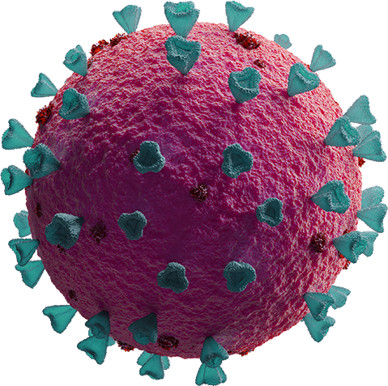
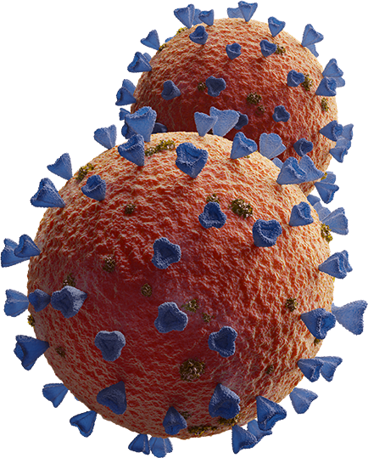
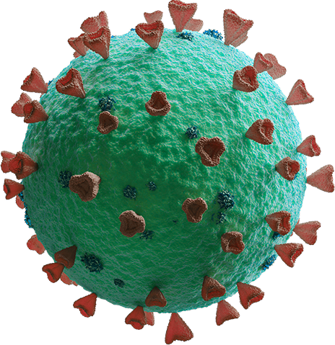
Predicting Monkey Pox virus
via photographs of skin lesions

Slide 2

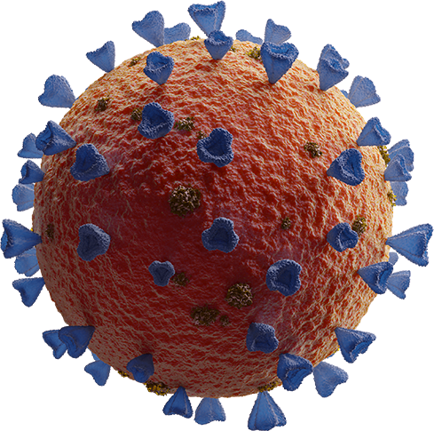
TABLE OF CONTENTS
01
02
05
03
04
INTRODUCTION
PROBLEM STATEMENT
CONCLUSION
IMAGE DATA
MODELLING

Slide 3
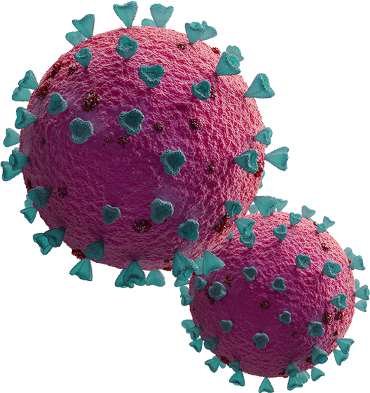
INTRODUCTION
Ongoing outbreak of monkeypox 2022
WHO declared an emergency as of 23 July 2022

Slide 4
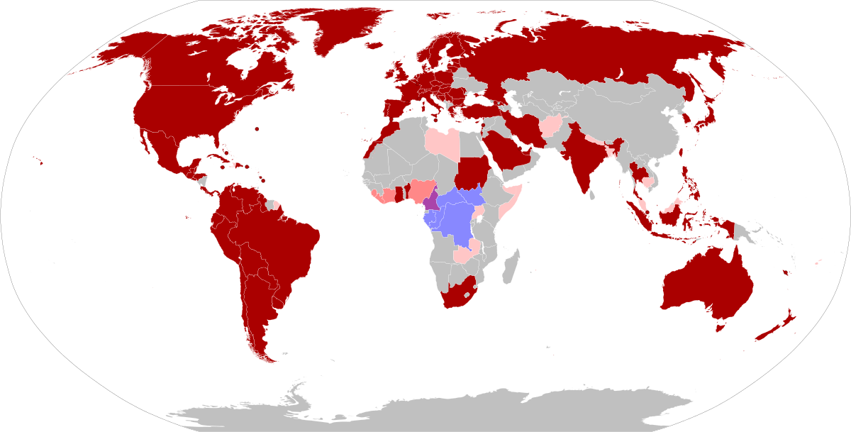
Both clades recorded
Clade II outbreak in 2022
Suspected cases

Slide 5
Monkey Pox
About the virus

Slide 6
BACKGROUND INFORMATION
Orthopoxvirus class, similar to smallpox
Zoonotic virus
Transmission; droplets, fluids, airborne
No known cure; smallpox vaccine
Risk of death; 1-5%
Incubation period; 8 - 21days

Slide 7
IDENTIFYING Monkey pox symptoms
Symptoms
Weeks
1-2
3-4
4-10
Onset of symptoms:
Fever
Muscle pains
Swollen glands
Lesions (a few)
Rash with many lesions.
Dry up, crusting and fall off
Recovery
May be still infectious

Slide 8
Problem Statement
Build a classifier model that can reliably and accurately predict monkeypox caused lesions

Slide 9
Why?
Reduce workload
Reduce time needed to identify
Reduce risk to medical staff
Optimize deployment of resources

Slide 10
Image Data

Slide 11
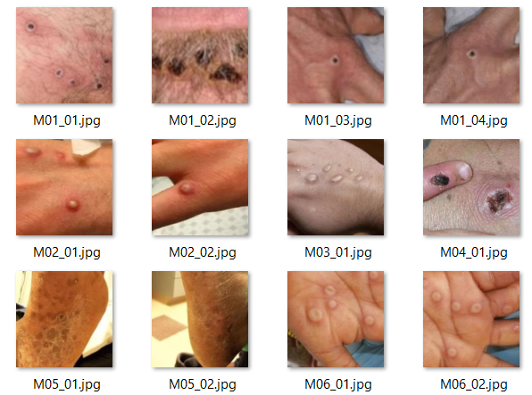
Original images; monkeypox
Coloured
Close up shots
Black and fairer races
Full body (kid)

Slide 12
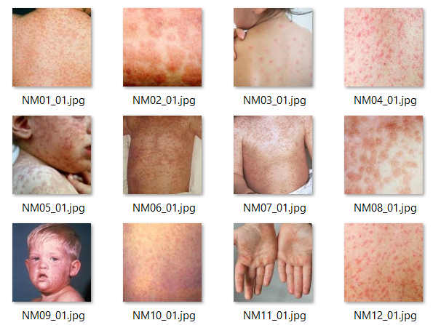
Original images; others
Coloured
Close up shots
Mostly fairer skinned races
Images of similar diseases, smallpox, chickenpox

Slide 13
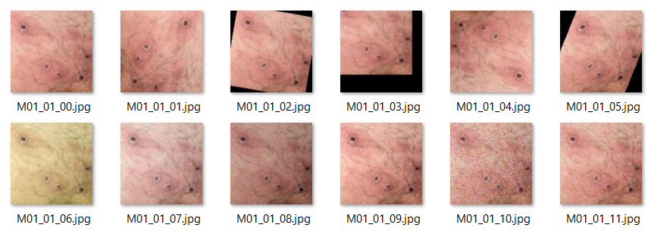
Augmented images
Rotate, resize, blurring, darken, discolouration, sharpening
13 images per original image

Slide 14
Modelling
Transfer learning/CNN Models

Slide 15
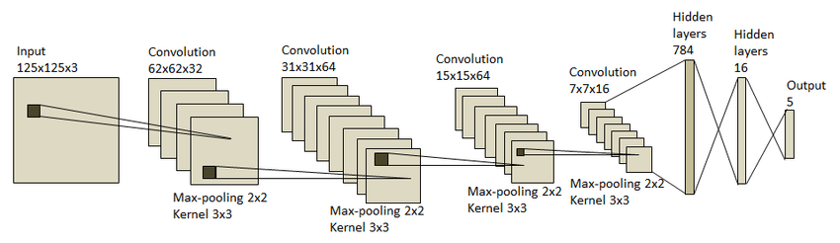
CNN model

Slide 16
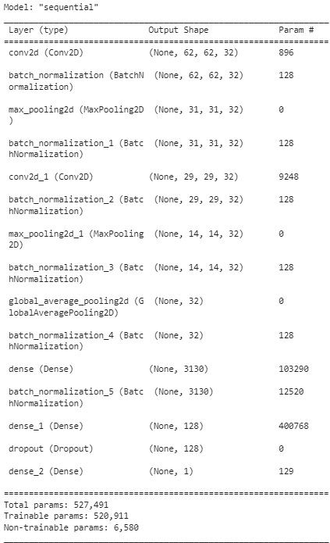
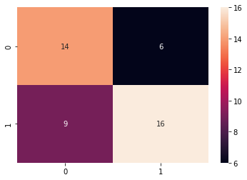
CNN model
Accuracy: 0.666
FP
FN
0 = Monkey Pox, 1 = Others

Slide 17
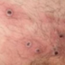
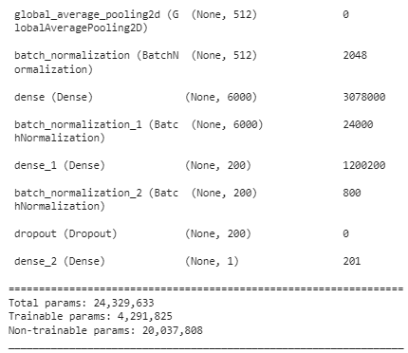
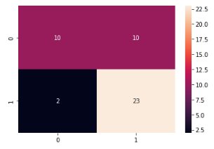
VGG19 Model
Input image
Accuracy: 0.733
VGG19 layers
0 = Monkey Pox, 1 = Others

Slide 18
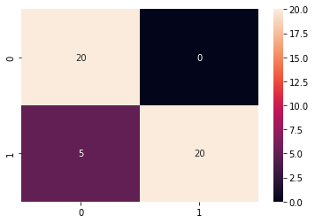
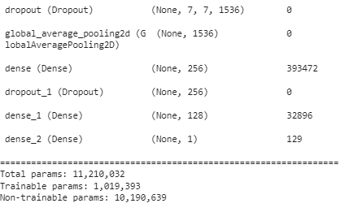
EfficientNetB3 Model
Input image
Accuracy: 0.888
EfficientNetB3 layer
0 = Monkey Pox, 1 = Others

Slide 19
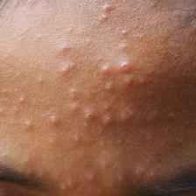
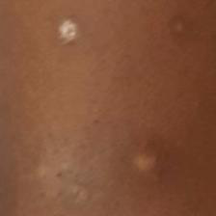
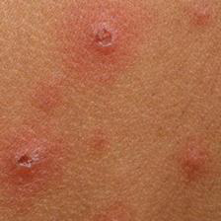
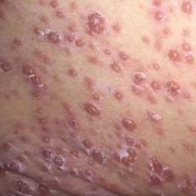
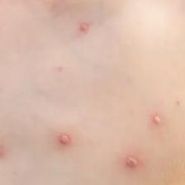
EfficientNetB3 misclassified Images

Slide 20
Conclusion

Slide 21
Future Improvements
More Images
Standardize images used
102 Monkey pox
126 Others
Use close up shots only
Time of onset
Other models
AlexNet, ResNet
Augment images
More variants; rotate

Slide 22
Conclusion
EfficientNetB3 Model is a suitable high accuracy model for predicting monkey pox by skin lesion images.

Slide 23
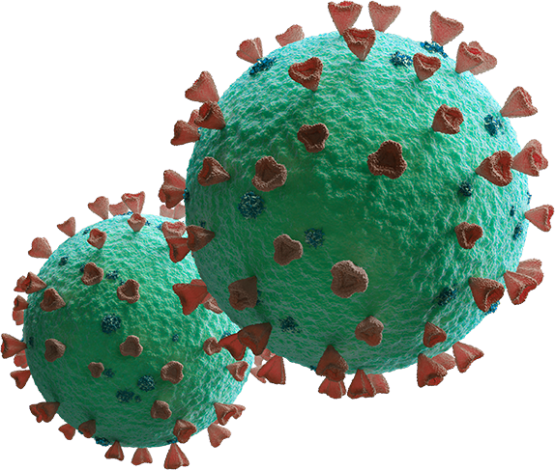
—Dave Waters
“Predicting the future is not magic, it’s artificial intelligence.”

Slide 24
THANKS!

